Slide 1
WORLD SUGAR MARKET OUTLOOK
FEDERATION OF SADC SUGAR PRODUCERS (FSSP) CONFERENCE
28th August 2019

Slide 2
PRESENTATION OVERVIEW
World Market Prices – Where we stand
Global Balance
Fundamental Drivers and Risks to the View in Key Markets:
Brazil
India
Europe
Thailand
What could this mean for SADC?

Slide 3
NO.11 PRICES – APPROACHING 10-YEAR LOWS

Slide 4
GLOBAL CHANGE IN SUGAR STOCK
YEAR-ON-YEAR PRODUCTION CHANGES
> BRAZIL : 1.0 MMT > INDIA : 4.0 MMT
> THAILAND : 1.7 MMT

Slide 5
GLOBAL CHANGE IN SUGAR STOCK

Slide 6
GLOBAL PER CAPTITA SUGAR CONSUMPTION IS NOT GROWING

Slide 7
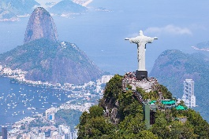
KEY MARKETS
BRAZIL
THAILAND
INDIA
EUROPE

Slide 8
BRAZIL – HIGHER ETHANOL MIX REDUCING PRODUCTION
Sugar Mix
CS Brazil Ethanol/Sugar Arbitrage

Slide 9
CS BRAZIL SUGAR PRODUCTION
CS Brazil Sugar Production and Sugar Mix

Slide 10
THAILAND: LOWER CANE RETURNS
Notes:
Cane price linked with WM

Slide 11
THAILAND PRODUCTION DECREASE
Thai Monthly Average Rainfall
Thai Cane Crushed by Season

Slide 12
INDIA – PRODUCTION DECREASE
Maharashtrian Monsoon Rains

Slide 13
INDIAN STOCKS ARE BUILDING

Slide 14
INDIA IN THE NEXT 12 MONTHS
1. 19/20 PRODUCTION AT 29MMT IS LIKELY TO EXCEED 26MMT CONSUMPTION.
2. INDIA STOCKS WILL INCREASE FROM ALREADY HIGH LEVELS.
3. THE GOVERNMENT HAS ANNOUNCED A 4MMT BUFFER STOCK.
4. EXPORTS NEEDED TO REDUCE STOCKS.
5. GOVERNMENT IS LIKELY TO SUBSIDIZE EXPORTS.

Slide 15
INDIA CANE PRICE MAINTAINS

Slide 16
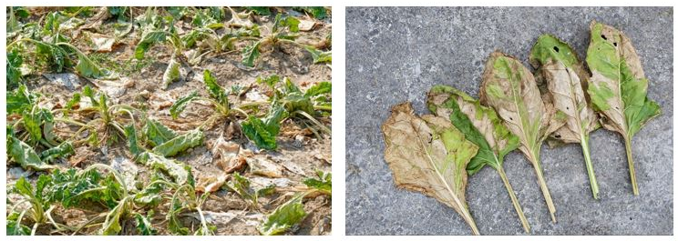
EU – HOT DRY WEATHER
EU Production
EU Beet Area Planted
German Beet Wilting From Extreme Heat - Source: @SouthGermanBeet
Notes:
Consumption line in the production chart

Slide 17
EU – PRICE REMAINING AT A PREMIUM
EU Imports Needed
EU Price

Slide 18
WHAT COULD THIS MEAN FOR EXPORTERS IN SADC?
THE WORLD SUGAR BALANCE IS SHIFTING TOWARDS A DEFICIT DUE TO REDUCTIONS IN PRODUCTION IN INDIA, EUROPE, THAILAND AND BRAZIL.
HOWEVER GLOBAL STOCKS HAVE REACHED RECORD LEVELS. SO WE DO NOT EXPECT NO.11 PRICES TO RISE SUDDENLY.
THE EU DEFICIT IS EXPECTED TO INCREASE THIS YEAR, MEANING THAT PRICES WILL NEED TO MAINTAIN THEIR PREMIUM VS THE WORLD MARKET TO INCENTIVISE IMPORTS FROM ACP/LDC ORIGINS, FTA ORIGINS AND CXLs.
4. EFFECTIVE RISK MANAGEMENT WILL BE KEY.

Slide 19
Questions?
This information has been prepared for information only and does not constitute an offer or commitment. This information does not constitute investment advice and is not intended for the use of professional or retail clients as defined by the rules of the FCA.
The firm or its staff members may trade on their own account and may from time to time hold or act as market makers in investments mentioned in this document. Please note that the firm makes no warranty, expressed or implied, as to the accuracy or completeness of the information and opinions herein. All parties are advised to seek independent professional advice as to the suitability of any products and to their tax, accounting, legal or regulatory implications.
The firm is authorised and regulated by the Financial Conduct Authority.

