Slide 1
FSSP CONFERENCE 2019
THE FUTURE OF SUGAR

Slide 2
The Sugar Sector as a Vehicle for Developing the Regional Economy
Mr Sikhumbuzo Dlamini

Slide 3
Presentation Outline
Importance of sugar industry in SADC.
Trade within SADC
How can sugar(cane) industry support drive to industrialise the sub-region?
Conclusion
Notes:
Major producers…. SA, Eswatini, Zimbabwe, Mauritius, Zambia, Tanzania and Mozambique

Slide 4
IMPORTANCE OF SUGAR IN SADC
The sugar industry in SADC, is a key driver of economic development, through backward and forward linkages, supporting industrial development and sustainable economic growth. In one SADC country, the sugar industry represents roughly 6.1% of the country’s GDP and 93% of the agricultural sector.
Supporting local communities: The sugar cane industry also plays an important role in local communities, from helping establish small grower schemes to providing healthcare, education, housing and infrastructure.
Building revenue and skills into the national economy: Sugar industries provide much needed export earnings and tax revenues to each host country, while the sugar production process supports the development of a range of engineering skills that transfer to other parts of the economy

Slide 5
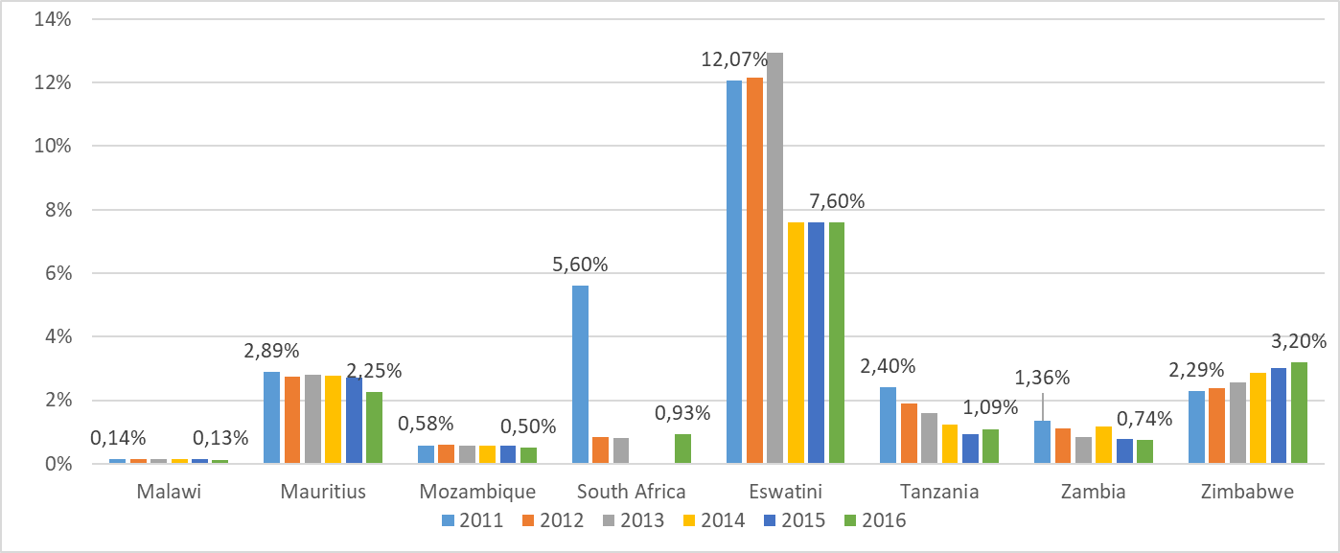
IMPORTANT FOR EMPLOYMENT CREATION
The sugar industry also contributes to poverty reduction in SADC. In one country, the poverty levels have dropped by over 4 per cent due in part to opportunities for rural people in the sugar industry.

Slide 6
SADC can satisfy its own sugar needs…
*Averages for 2015-17
Source: ISO yearbook 2018
Notes:
Major producers…. SA, Eswatini, Zimbabwe, Mauritius, Zambia, Tanzania and Mozambique

Slide 7
Average SADC Production Share
Source: ISO yearbook 2018
Notes:
Major producers…. SA, Eswatini, Zimbabwe, Mauritius, Zambia, Tanzania and Mozambique

Slide 8
Cost of production relatively low but rising…
Notes:
There is a need to minimize costs of production to below world cane average for the countries which are above the world average
Countries with below the world cane average costs …… Malawi, Zimbabwe, Zambia and Eswatini

Slide 9
Trade within SADC
Intra-regional trade in Africa has for some years been an important center of discussion in the regional integration agenda…
…And SADC is no exception to this topical issue;
Most intra-regional trade tends to happen between developed nations and it is still small among African RECs;
Despite numerous efforts by African Heads of States to promote intra-Africa trade, there has not been significant increase in intra-regional trade especially in Southern Africa.

Slide 10
Intra-SADC Trade Still Remains Very Low
According to a study by OECD, July 2017, intra-SADC trade has increased slightly since the creation of the Free Trade Area (FTA) in 2008 with an estimated 85% of intra-regional trade subject to zero duty;
According to that study, Intra-SADC trade hovers around 10%, and this is low compared to other regions like the South-East Asian Nations (at 24%) and the EU (at 40%);
This implies that about 90% of SADC’s trade is happening with external countries; [That’s why the sugar industry contributes significantly to Forex]
If any trade does happen within SADC, it could be influenced by South Africa which enjoys a significant trade influence in the region due to her economic size relative to the other member states within SADC;
RSA’s imports from SADC are low compared to its exports toward SADC countries, which creates a structural trade imbalance with the regional partners;
This shows that there is a huge market in SADC since SADC region is a non-negligible market for RSA.

Slide 11
SADC Trades More With Rest of the World
According to SADC Statistical Yearbook (2018), SADC tends to trade more with the rest of the world as depicted by both exports and imports;
Intra-SADC Exports averaged $34.3 billion from 2006 to 2015 against $148.3 billion average in extra-SADC exports;
The same applies for imports: Averaging $33.4 billion (intra) vs $144.6 billion (extra)

Slide 12
SADC Trades More With Rest of the World
SADC has relatively enjoyed a positive trade balance (surplus) with the rest of the world;
This implies that SADC exports more than it imports from RoW save for 2009, 2012, 2014 and 2015 when trade deficits were recorded.

Slide 13
SADC Trades More With Rest of the World

Slide 14
SADC Sugar Exports Low Relative To World
According to ISO Year Book (2018), SADC Member States are lagging behind on the production of and trading in sugar;
This is shown by the proportion of SADC sugar trade as a share of world sugar trade which hovers below 5% from 2011 to 2017;
The trend has been deteriorating towards the latter years, reaching a low of 2.6% in 2016 before rising to 3.0% in 2017.

Slide 15
Collectively, Average For SADC Countries Exports of Sugar Relative To Total Exports Still Very Low
Drilling down to SADC Member States indicates that even their average share of sugar exports to total exports are not very impressive (below 8%);
With the exception of Mauritius, Eswatini and Malawi which have sugar exports accounting for 15.2%, 14.8%, and 8.4% respectively to their total exports;
And this could be due to their small size of their economies.

Slide 16
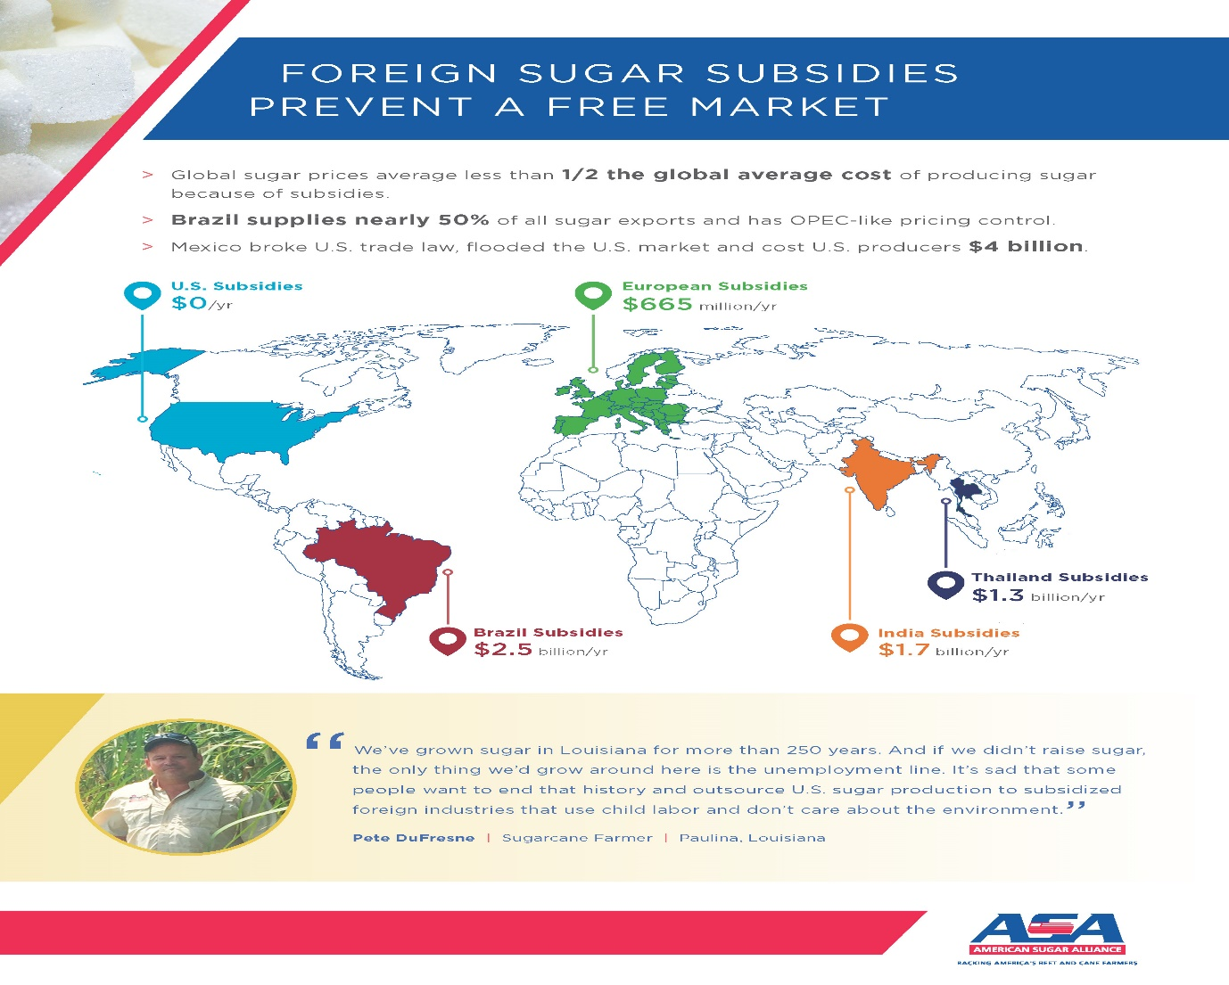
The world sugar market is highly distorted..
Notes:
The ongoing discourse on the new world trade order provide an opportunity for SADC sugar producers (through their governments) to lobby for dismantling of trade barriers.
However, necessary reforms have to be undertaken in the sub-continent to improve competitiveness….

Slide 17
Southern Africa has an integration plan: but it’s short of sector specifics*
The Southern African Development Community (SADC) has placed industrialisation at the centre of its regional integrated development plan and a roadmap has been drawn up to guide the plan. But implementation has been poor and not a lot of headway has been made to integrate the economies of the region.
Recent studies on value chains in the region highlight high transport costs and continued use of non-tariff barriers in some countries as some of the main reasons for poor progress.
These studies suggest that the region needs a coherent sector-specific approach to support the development of regional value chains. That should be supported by efforts to reduce trade barriers. In addition, the impact on industrialisation that large multinationals have had should be considered.
*Pamela Mondliwa, Researcher, Centre for Competition, Regulation and Economic Development, University of Johannesburg

Slide 18
Southern Africa has an integration plan: but it’s short of sector specifics….cont’d…
This is where the sugar (sugarcane) industry comes in.
The importance of developing regional value chains is more critical than before, if the region is to benefit from investments in the sugar industry.
The FSSP should prioritise developing a regional roadmap to industrialise the sugarcane industry. This would help attract investments and ensure the region reaps the benefits of the Continental Free Trade Area.

Slide 19
Beneficiation is key…
The industrialisation strategy stresses the urgent need for the region to make use of its abundant and diverse resources – particularly in agriculture and mining. Its key aim is to foster industrialisation through beneficiation – a process of transforming primary raw materials into a more value added finished product – and value addition.
This approach is informed by two big challenges related to trade. First, is that intra-regional trade is low. And that trade between countries is dominated by low value products.
There is a need to develop regional value chains - only a regional approach to promoting value addition will work. It must focus on building productive capacity of industries, developing infrastructure and promoting technology.

Slide 20
Value addition is the answer…
Over the year, more and more sugar industries are transforming to co-produce sugar, ethanol and electricity and other by-products.
World’s two largest cane producers, Brazil and India, have access to sugar, regulated electricity and ethanol markets.
With the current huge deficit in the SADC power pool, there is an urgent need for co-generation. Expanding the production of clean renewable sugarcane products may have the potential to enhance energy security and create jobs.
In addition, there are opportunities for bioplastics, bio-hydrocarbons and biochemical.

Slide 21
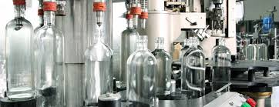


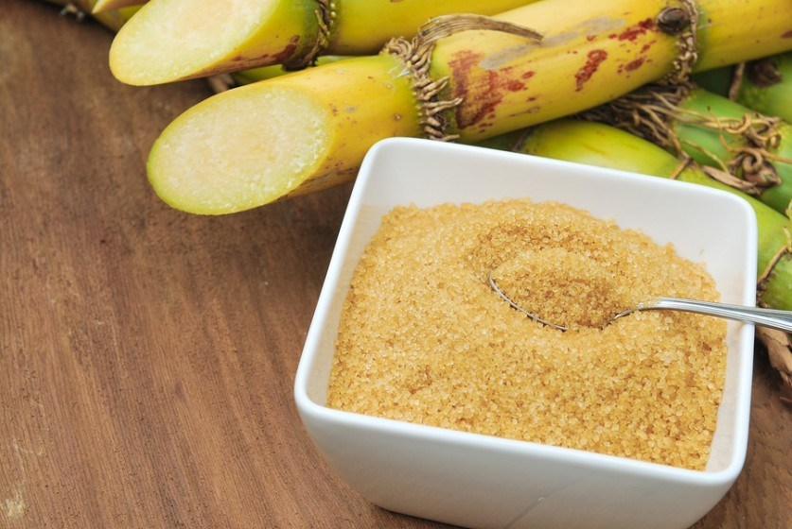
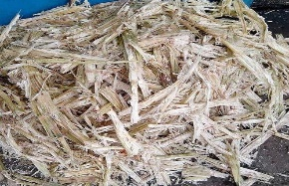




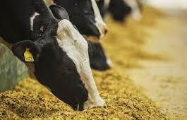

Beneficiation is the key – there is a lot more to the sugar industry…
Further products
By Products
Ethanol and spirits
OK sugar , then what?
Molasses
Bagasse
Disposable packs
Pellets for fuel
Filter Mud
Writing paper
Cane wax
Animal Feed
Notes:
the production of green energy and biofuels
developing products such as bio-chemicals and bio-plastics
speciality sugars and organic sugar production

Slide 22
Some key take aways…
INNOVATION and a firm grasp of international trends linked to climate change and consumer demand are key if SADC sugar producers are to enjoy sustained growth in the face of rising costs, unpredictable weather patterns and the global anti-sugar lobby.
ANTI-SUGAR LOBBY IMPACTS ARE REAL – the demand trends are influenced by sponsored lobbyist who want many to believe sugar is bad!
BENEFICIATION would have a positive impact on key macroeconomic variables in most of the SADC economies, i.e. foreign exchange, GDP, employment, trade creation, etc.
The future of the sugar industry is a vibrant sugarcane industry embracing diversification, innovation and cost efficiencies.

Slide 23
THANK YOU VERY MUCH FOR YOUR ATTENTION

